Slide 1
Errors and Exceptions
Notes:
Hello and welcome back. It might be hard to find somebody who hasn’t encountered error while programming. In this video we will discuss different types of errors and techniques to handle them.
<Click>

Slide 2
Errors are the mistake made while writing a program.
Types of Error
Syntax Error
Logical Error / Exception
Notes:
Every programming language has a predefined set of rules for writing the instructions. When the structure of the programming language are not properly followed or when we try to perform illegal operations, then the interpreter raise or throws an error. We, as a programmer can make certain mistakes while writing a program. Due to such mistakes, the compiler or interpreter raises an error.
<Click>
The errors may be syntactic or the logical errors. The errors are classified into two broad categories: Syntax errors and Logical Error or exceptions. Failure in fulfilling the proper structure or syntax of a programming result in syntax error and attempt to perform illegal operations or operations that are not allowed results in logical error or exceptions. Let’s discuss each of these in more details in the upcoming sections.
<Click>

Slide 3
Syntax error are the mistakes in the use of python language and are analogous to the grammatical mistakes in language like English
Can you identify syntax error in the code?
# initialize the variable
threshold = 100
number = 2
# check if the number is smaller than threshold
if (number<threshold)
print("The number is smaller than the threshold")
Notes:
Syntax error are the mistakes in the use of python language and are analogous to the grammatical mistakes in language like English. The program exit with the error message without running or executing the program if there are any mistakes in syntax. The syntax error are the most common types of error. If you are the beginner of the programming language, then you are most likely to make the syntax errors. Every programming language has its own standard rule or syntax to define different entities like variables, creating functions, loops, conditional statements etc. When the syntax, or to be specific, when the grammar rule of the programming language is not followed properly, then the interpreter or compiler throws a syntax error. Before executing the program, the compiler or the interpreter first parse the program to check if the program is syntactically correct or not. If the compiler/interpreter detect the error in the syntax, then it throws an error called syntaxError.
<Click>
Here is a simple program to check if the number if less than threshold value. If the number is less than threshold, then, it will print the statement inside the if statement. There is a syntax error in this program.
<Click>
Can you identify the error? Some of you may miss the error. You can try to run the above code yourself and compiler will give you the location of the error in the error message. The if statement in python must be followed by the condition which is followed by the colon symbol. The colon is missing in the above code.
<Click>

Slide 4
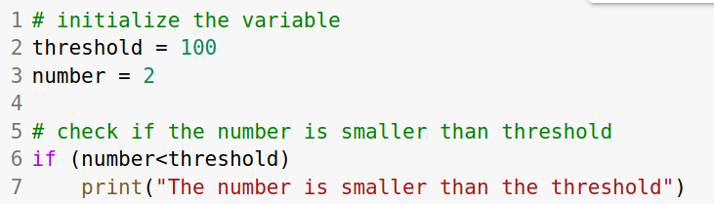
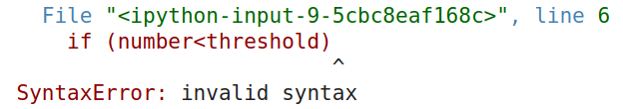
Informations in error message
File name
The line number
The proximate location
Error Type
Notes:
The error message generated by the interpreter for the above code is shown below. The error message contains the information about the location at which the error occurred. The interpreter only shows the location of the first occurrence of the error though we can have errors at the multiple locations. The parsing stops at the location where the error is detected.
<Click>
The error message contains enough information that allows us to identify the error and correct it.
The error message contains the following information:
<Click>
The name of the file at which the error has occurred. A large project can have hundreds of modules or .py file. So the file name helps to identity the very file.
<Click>
The second information in the error message is the line number at which the error has occurred.
<Click>
The third information is the exact or nearest location of the error. This location is pointed by the cap sign.
<Click>
And the fourth information is the type of error that has occurred.
Note that both syntax and logical error message contains these informations.
Let’s see if we can identify these information in the error message shown.
<Click>
The first line of error message shows the name of file and the line number at which the error occurred. Since this code was run in ipython file, so the file name contains some random string. If we notice carefully, the error has occurred at line number 6 which is shown in error message.
<Click>
Similarly, the second line of error shows the exact or the nearest location at which the error has occurred. It is pointed by the cap symbol.
<Click>
Similarly, the last line shows the type of error. Here, the error is syntax error. The name of exception is followed by its description.
<Click>

Slide 5

Logical Errors/Exceptions occurs due to the illegal operations that are not allowed.
Few logical errors:
from math import square
Divide a number by zero
Read a file that doesn’t exist
Import module that doesn’t exist
and so on…...
ZeroDivisionError
FileNotFoundError
ImportError
Notes:
Even if the program is syntactically correct (pass the syntax test), it may encounters error during its execution. The errors that occurs due to the illegal operations that are not allowed are called logical errors or exceptions. Logical error are raised during the runtime of a program. There are different logical errors that can occur during the execution of a program.
<Click>
For instance, when we attempt to divide a number by zero, the compiler raise an logical error because it is a illegal operation.
<Click>
If we attempt to read a file that doesn’t exist, the compiler throws an error.
<Click>
If we try to import the module that doesn’t exist, the compiler throws an error.
<Click>
And there a numerous illegal operations that can raise an error.
Whenever the python encounters these runtime errors, python creates and raise an exception object.
<Click>
The corresponding name of the exception object is shown. Division by zero raise an ZeroDivisionError exception. Similarly, attempt to read the file that doesn’t exist raise an FileNotFoundError and attempt to import module that doesn’t exist raise an ImportError. The name of these exceptions object is printed out along with error message.
<Click>

Slide 6
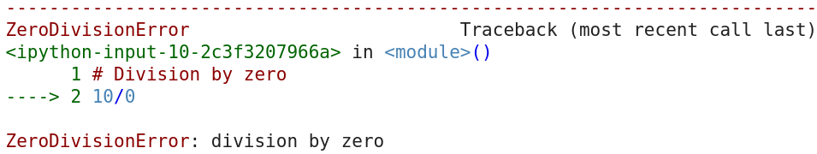

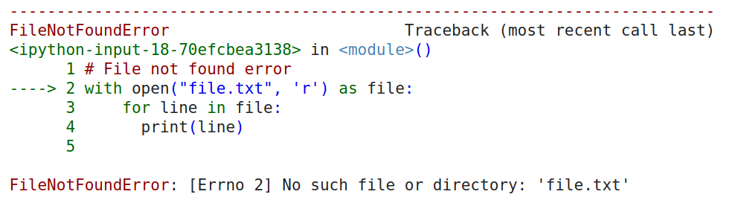
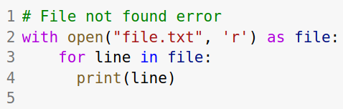

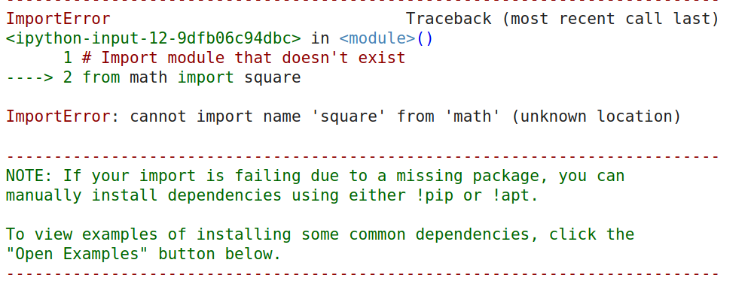
Notes:
The figure shows the illegal operations and their corresponding error message. Notice that the error message contain the name of the exception class that is raised. The line of the error is indicated by a arrow line.
<Click>
For instance, an attempt to divide a number by zero raises an ZeroDivisionError as seen in the error message.
<Click>

Slide 7
Code Demo
Notes:
If we attempt to divide a number by zero, <Run> the interpreter throws a ZeroDivisionError. The error message highlight the line where error occur using a dotted arrow line. Similarly, it contains the name of raised exception class and description of the exception.
<Next>
Similarly, if we attempt to import module or function that doesn't exist,<Run> then, python raises an exception of class ImportError.
<Next>
Similarly, if we access the variable which is not defined so far, the python raises an NameError.<Run>. As seen with the help of an above examples, as soon as the error has occured, the program is terminated. With such termination, the program is said to crash.
<Click>

Slide 8
Built-in Exceptions
Notes:
Until now, we have discussed few exceptions that are raised when the corresponding error occured during the execution of the program. Exceptions are the raised during the illegal operations in the program. These operations cause program to move to the unexpected state and hence the program terminates unexpectedly. Just before the termination of, an exception is raised by the interpreter along with the error message. In python there are several built-in exceptions that are raised when the corresponding error occur. We have already discussed few built-in exception in the previous section.In this sections we will list out few more of them.
<Click>

Slide 9
Built-in Exceptions: print(dir(locals()['__builtins__']))
Built-in Exceptions | Description
ArithmeticError | It occurs due to error in arithmetic operation
KeyError | It occurs when the key of dictionary is not found.
MemoryError | It occurs when the program run out of memory
StopIteration | It is raised by built-in function next() or iterator's next() method
TabError | It occurs when the indentation contains an inconsistent use of tabs and spaces.
Notes:
We can print out all the built-in exceptions using the built-in function locals() as shown.
<Click>
The table shows few built-in exceptions other than those we have discussed in the previou section.
ArithmeticError exception is raised when then there is error in the arithmetic operation.
Similarly, KeyError exception is raised when the key of the dictionary is not found. You have already experienced this error while working with the dictionary.
MemoryError occurs when the program runs out of memory.
You have already discussed about iterators and iterables. So you must be familiar with next() method in the iterator. The StopIteration error is raised by the built in function next() or iterator’s next() method to indicate that there is not further element to be raised by the iterator.
TabError is raised, if the indentation contains an inconsistent use of tabs and spaces.
<Click>

Slide 10
Hierarchy of the exceptions
BaseException
Exception
SystemExit
StopIteration
KeyboardInterrupt
ArithmeticError
GeneratorExit
BufferError
Exception
ImportError
MemoryError
Notes:
In python, there is a hierarchy of exceptions one derived or inherited from another. BaseException class is the base exception class of all the exceptions in python. It means all the exceptions in python are inherited directly or indirectly from the BaseException class.
<Click>
The exception class like SystemExit, KeyboardInterrupt, GeneratorExit, and Exception classes are derived from the BaseException class.
SystemExit exception class is raised by the sys.exit() function which indicates the system exit.
Similarly, the KeyboardInterrupt is raised when the user hit the interrupt key, i.e, control +C during the execution of the program.
GeneratorExit class is raised when the generator is closed.
And Exception class is a general exception class. All built-in, non-system exiting exceptions are derived from this class. All user-defined exceptions also should also be derived from this class. We will discuss about user-defined exceptions in the upcoming sections.
<Click>
A large number of exception are derived from the Exception class. Few exception classes like StopIteration, ArithmeticError, BufferError, ImportError and MemoryError have been already discussed in the previous section. There are many other exceptions; you can find the list of all exceptions using the built-in local() function as discussed in the previous section.
<Click>

Slide 11
Exception Handling
Notes:
Errors or mistakes in a program are generally called bugs. The syntax error can be tackled immediately. But the logical errors are difficult to detect even after the several runs of a program. Suppose we built the application that allows users to perform different arithmetic operations like addition, subtraction, multiplication and division. Suppose the user attempts to divide a number by zero. Such illegal operations terminate or crash the program. We may need to restart the application. The application should be immune to such unexpected situations. In other words, the exceptions should be handled properly so that the program doesn’t crash.
The attempts like reading a file, or getting input from the end user are more prone to cause exceptions as the file may not exist and the user may attempt to input random values.
<Click>

Slide 12
Exception Handling provides an alternative flow of execution to avoid crashing the program unexpectedly.
Do this
No exception
Code
Exception
Do that
Notes:
Exception handling provides an alternative flow of execution when the exception occurs. This alternative flow avoids the unexpected crashing of the program.
<Click>
Handling the exception means to tell the program what to do when the exception is raised. The alternative path save the program from getting crashed. When there is not exception, the normal flow of the program will be executed.
You might be wondering what sorts of code may come in the handling part. At the exception handling part, we may inform the user what sorts of operation are not allowed. For instance, in the application that performs division, if the user attempt to divide a number by zero, we can simply inform him that the division by zero is not allowed.
Once the exceptions are handled properly the program won’t terminate unexpectedly.
Until now, we have discussed few built-in exception and briefly discussed how we can handle them. Let’s discuss few tools python provides us to work with the exceptions.
<Click>

Slide 13
try, except, finally
Syntax:
try:
# Code
except:
# Code
Try to run this code. If an exception is raised, stop the execution.
Run this if an exception is raised in the try block. Otherwise skit it.
finally:
# Code
Notes:
Python provides clauses like try, except, finally to perform exception handling. The finally clause is optional. Let’s first discuss about try except clause.
<Click>
The syntax of try except clause is shown below. The part of code that is unsafe and possible can raise exception are placed in the try block. The code for handling the exception is placed in the except block.
<Click>
The try block basically tries to execute the block of code. If an exception is raised, it immediately halts the execution of the code in the current try block and shift the control flow to the except block.
<Click>
And the except block run this code if an exception is raised in the try block. If no exception is raised, the code in the except block is skipped.
<Click>
And the finally block is a optional part. The finally block is used for final cleaning part of code, if necessary. For instance, if we have opened a file to read in the try block. The cleaning part for the file may contain closing it. The finally block is executed not matter an exception is raised or not.
<Click>

Slide 14
Example:
numerator = int(input("Numerator:"))
denominator = int(input("Denominator:"))
result = numerator/denominator
print(result)
try:
# Code
except <name> :
# Code
numerator = int(input("Numerator:"))
denominator = int(input("Denominator:"))
try:
result = numerator/denominator
print(result)
except:
print("Division by zero is not allowed.")
except <name2> :
# Code
except:
# Code
Notes:
Let’s see an example of try, except clause.
Suppose we have an application that asks the user for numerator and denominator and performs division. The particular code snipped for this part of application might look something like shown in the monitor.
When the user enters 0 at the denominator, the application is certain to raise exception and then crash as the exception is not handled.
Can anybody guess, how we can handle the exception if raised and hence prevent the application to crash?
<Click>
Well we can use try except clause. The screen shows the same code with exception handled. The divisions between two number may raise exception. So we have place that unsafe part of code in the try block. This makes sure that the except part will be executed if the exception is raised in the try part. The except block simply print out the message that division by zero is not allowed.
Adding these just few more lines of code for handling exception prevents the unexpected termination or crash of the program.
One block of code can raise more than one exceptions. Using only except clause handle all of the raised exceptions in the same way. But we may want to handle different exceptions differently. For instance, we may want to handle ZeroDivisionError exception in one way and NameError exception in different way.
<Click>
To handle the specific exception, we can pass the exception class name after the except clause as shown.
<Click>
Similarly, if we want to handle more than one exceptions we can pass another except clause followed by the name of exception we may want to handle.
<Click>
If the code block can raise more than two specific exceptions, we can handle all the remaining exceptions using an except clause.
Let’s summarize how this try except clause works.
If there is an error in the code placed in the try block, an exception is raised. If the name of the raised exception matches with the name placed in the first except clause, it will be handled there. If not the interpreter checks if the name matches in the second except clause. If the name of the raised exception doesn’t matches with any of the name, the exception remains unhandled. To prevent the exception go unhandled we generally put just a except clause with no name at the last. Since except can handle any type of exception, the exception won’t be left unhandled.
<Click>

Slide 15
Code Demo
Notes:
Here is a simple program that asks the user to input two numbers and perform division on them. <Run>. Let's pass a number 8 for numerator and 4 for denominator. And the result is 2. The program works fine. <Run> Now let's pass 8 for numerator and 0 for denominator, then the program raises an zerodivisionerror. Here, the division part of the code is unsafe and can raise an exception.
<Next>
We can handle this error by putting the division part of code in try block. So if the exception is raised in the try block, the execution immediately switch to the except block and preventing the program to terminate unexpectedly or simply crash.<Run> Let's pass a number 8 for numerator and 0 for denominator. The program terminate gracefully without error.
<Next>
Similarly, we can have multiple except block each handling the specific raised exception. Having multiple except block allows us to handle different exception differently. For instance, the execution flow enters in the first except block if the raised exception is ZeroDivisionError. The execution flow enters in the second except block if the raised exception is a NameError. If the raised exception is other than first two, the last except block with no name handles all error that occur due to programmers flaw. <Run> Here the variable y is not defined, so NameError is raised which is handled by second except block.
<Next>
Let's try to read a file file1.txt that doesn't exist. In the try block, we have opened and read the file. The except block is executed if there is an error while reading a file. The finally block will be executed no matter the error is occured or not. The finally block is optional and generally contains the clean up code. Here we have closed the file in finally part. So finally part close the file not matter it is read successfully or there was an error during reading a file.
<Click>

Slide 16
raise, assert
Notes:
Until now, we have discussed how to handle exception in python. Exception are raised automatically by the interpreter if we try to perform illegal operation. Python allows us to explictly raise an exception based on our requirement. raise and assert are the keywords generally used for that purpose. The raise statement allows us to explicitly raise an exception. Explicitly raising an expectation can be helpful in some scenarios. And assert statement allows to enforce a certain condition, and if the specified condition doesn’t meet, an exception will be raised.
Meanwhile, you might be wondering that for the illegal operations, the interpreter automatically raises and exception and why would somebody need to explicitly raise an exception. If you are also thinking this, you are not the only one to think so. Let’s discuss why anybody would explicitly want to raise an exception in the next section.
<Click>

Slide 17
Illegal Operations:
def factorial(n):
if n==0:
return 1
else:
return n*factorial(n-1)
def factorial(n):
if n < 0:
raise Exception("The factorial of negative integer is not defined.")
if n==0:
return 1
else:
return n*factorial(n-1)
factorial(-5) #illegal operation
Notes:
To formally discuss about the raise statement, let’s briefly discuss about illegal operation. Illegal operation are those operations that are not allowed for a given application. The division by zero is an illegal operation and it is universally illegal. The definition of illegal also depends on the task at hand.
<Click>
Suppose we want to compute the factorial of a number. We have already discussed about factorial in the function unit. The factorial of a negative number is undefined.
<Click>
So passing a negative number to the factorial is a illegal operation. Passing the negative value to this function will cause the program to go in infinite loop. However, passing a negative number to this function is complete legal for interpreter and it won’t raise an exception. So we should explicitly raise an exception.
<Click>
We can rewrite this function to raise an exception as shown. Here we raised an exception of class Exception explicitly. We can raise an exception of other class based on the requirement.
<Click>

Slide 18
assert
Syntax:
assert <condition> <”string to display error if the condition fails”>
def factorial(n):
assert n>=0 “The factorial of negative integer is not defined”
if n==0:
return 1
else:
return n*factorial(n-1)
Notes:
The alternative to raising an exception is to use an assert statement. Assert statement is used to enforce a certain condition.
<Click>
The assert statement has the following syntax.
We use keyword assert which is followed by a condition and then followed by a string to display with error message when the condition fails.
When the condition specified fails, the assert statement raises an AssertionError with the specified message string.
<Click>
We can prevent factorial from undergoing into infinite loop using assert statement as shown. As seen assert statement is very easy to use and can be very useful to prevent unexpected flow of program.
<Click>

Slide 19
Code Demo
Notes:
Here is a simple code to compute the factorial of a number. An attempt to compute the factorial of a negative number is an illegal operation as it will leave the program in infinite loop. Eventually, the program will be sort of memory.
<Next>
The solution is to raise an exception explictly. <Run> With this, we don't need to worry if the program will be in an infinite loop. We can handle this exception gracefully by using exception handling technique as discussed earlier.
<Next>
The alternative solution is to use assert statement. The assert statement quite simple. We can reinforce certain condition using a assert statement. <Run> Here, the value of n is negative, so assert statement raised an assertion error with error message specified in quote. And to prevent unexpected termination caused by assertion, we can gracefully handle it.
<Click>

Slide 20
User-defined Exception
Notes:
Based on our requirements, we can create a customized new exception class. The user-defined exceptions should be derived or inherited directly from the Exception class or from the child of Exception class.. Let’s see how we can define a user-defined exception.
<Click>

Slide 21
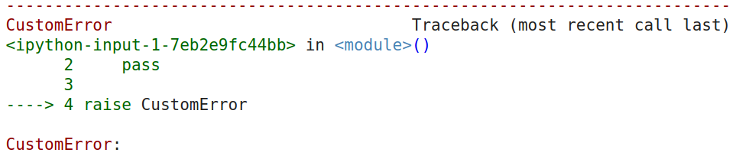
How to define a user-defined exception?
Syntax:
class <exception_name>(Exception):
# Code
class CustomError(Exception):
pass
raise CustomError
Notes:
Defining a user defined function is same as defining a class. We have already discussed about the concept of object oriented programming in the previous chapters.
<Click>
The syntax to define a user-defined exception is shown in the screen. The defining is starts with the keyword class followed by the name of the custom exception. The custom or user-defined exception in inherited from the Exception class. The body of the custom exception contains the relevant codes.
<Click>
One of the simplest user-defined exception class is shown in the screen. The user-defined exception with name CustomError inherits from the Exception class. Like regular built-in exception we can raise the user-defined exception as shown.
<Click>
When we raise the exception, the error contains the following. The last line of error shown the name of the custom exception we have just defined.
We can further customize the error by passing the additional arguments to the exception class.
<Click>

Slide 22
Code Demo
Notes:
Defining a user-defined exception is same as defining a normal class. User-defined exception should be inherited from Exception class. <Run> Like built-in exceptions, we can raise it and handle it.
<Next>
User defined exception can be customized using additional arguments. Here we have defined a BankBalanceNotValid exception class whose constructor takes in amount, and message as argument. As we know, the bank balance can't be less than 0. So this exception will be raised when the balance is less than 0. <Run>
<Next>
We can then asks the user to input their bank balance. <Run> Suppose if the user input -100, then the custom exception will be raised with the specified error message. If necessary we can handle the raised exception.
<Click>

Slide 23
Debugging
Notes:
Debugging is the process of identifying and resolving the existing or possible errors in the software code. In this section, we will discuss about debugging.
<Click>

Slide 24
Bugs are errors, mistakes, fault or problems that cause the program to crash.
Debugging process
Causes:
1. Reproduce problem
Erroneous logic
Human error
2. Record the program snapshot
3. Analyze the snapshot
4. Fix the bug
Debugging
Debugger: A tool used for debugging
Notes:
Before discussing about debugging and tools used for debugging, let’s briefly discuss about the bugs.
Bugs are errors, mistakes, fault or problems that cause the program deviate from the expected results and cause the program to crash.
<Click>
The cause of the bug in the program are the illogical or erroneous logics. These bugs are due to the mistakes of the humans, probably failing to create a software product that works normally for all input inputs or all possible states. For instance, attempting to compute factorial of a negative number is illegal and is considered as bug. Bugs are inevitable. A carefully designed software may contains smaller proportion of bugs. Lack of proper software testing also results in bugs. Despite the careful inspecting the software may contains bugs and it might takes very long time to detect those bugs.
<Click>
Debugging is the process of detecting and removing the bugs in the program
<Click>
A debugger is a tool used for debugging.
<Click>
The debugging process generally consists of a series of steps. The motive of the debugging process is to detect the cause of bug in the program.
<Click>
The first step of debugging process is to reproduce the problem itself. We can’t detect problem if it never occurred.
<Click>
The second step is to record or capture the state or snapshot of a program when the bug has appeared. By state, we mean the content of each variables.
<Click>
The third step is to analyze the snapshot or variables. The analysis may include comparing the variable state when the bug has occurred and not occurred. With this analysis, we try to identify the cause of bug in the program.
<Click>
Final step is to fix the bug. We need to make sure that we don’t introduce another bug while fixing the existing one.
<Click>

Slide 25
Debugging tools and techniques
Exception Handling
Assertion
Python logging modules
Python debugger module(pdb)
Jupyter Notebook
Notes:
There are many debugging tools and techniques available to debug the program. In this section, we will discuss few tools and techniques.
<Click>
The first technique to debug a program is to carefully use the technique of exception handling. We should put the unsafe code in the try block and handle it by printing the useful error message which we can use to detect the bug. Moreover we handle each exception type separately using multiple except block so that we can identify the actual bug.
<Click>
The second technique might be to use assert statements at the multiple section of the code. Suppose we know the expected state of the program. We enforce the program to be consistent with the expected state. assert statement will raise an exception when the state deviates from the expected one.
<Click>
The third technique might be to use python logging modules. Logging technique generally logs all the state of the program in a file. The logs are recorded in a human readable format. We can use this file to identify the cause of error in the program.
<Click>
The another technique might be to use python debugger module. Python provides many debugger tool that simplifies the debugging process. Python has a built-in debugger called pdb which is a command line tool. It can be used to monitor the state of a program line by line. The discussion of this too is out of the scope of this video. You are highly encouraged to learn it.
<Click>
Another technique of debugging is to use jupyter notebook. Jupyter notebook enables to execute each block of code separately. We can just focus on the part program that may contain bug, monitor the state of each variable.
<Click>

Slide 26
Key Takeaways
Errors are generally classified as Syntax error and logical error.
Python raises an exception with the error message when it encounters the mistakes in a program.
try/catch/finally statements are used to handle exceptions.
raise statement is used to explicitly raise an exception based on the requirement.
Exception handling, assertion, logging module, debugger module, etc are used for debugging the program.
Notes:
In this way, we are at the end of this video. Before we end up this video, let’s list out few key takeaways of this video.
<Click>
Error are the mistake made while writing a program. The error might be syntactic or the logical one. Logical error are more severe than syntax errors.
<Click>
PYthon raises an exception with the error message when it encounter the mistake in the program.
<Click>
try/catch/finally statements are used to handle catch the exception and handle it.
<Click>
The definition of illegal operation depends on the tasks at hand. Sometimes we may need to explicitly raise an exception for the illegal operation. For this we use raise statement.
<Click>
Debugging is the process of identifying and resolving the existing or possible errors in the software code. Exception handling, assertion, logging and debugger module are used for debugging the program.
This is it for now. And will see you in the next video. Until then, good bye and have a good day.
<Click>

